Slide 1
CS 4700 / CS 5700 Network Fundamentals
Lecture 11: Transport
(UDP, but mostly TCP)
Revised 7/27/2013

Slide 2
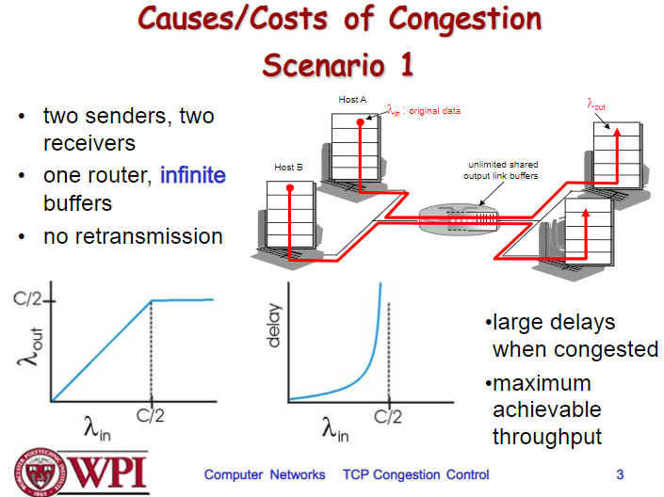

Slide 3
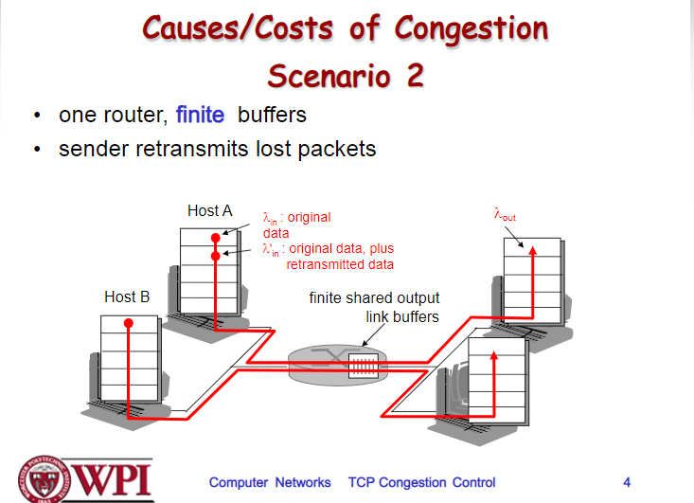

Slide 5
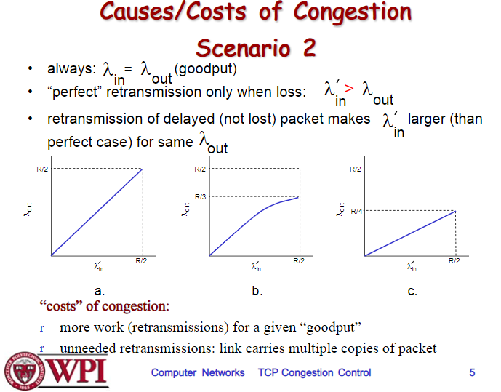

Slide 6
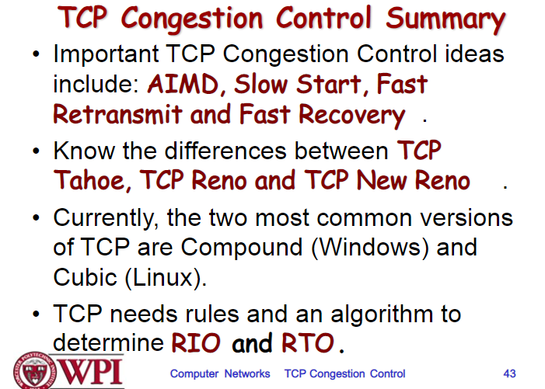

Slide 7
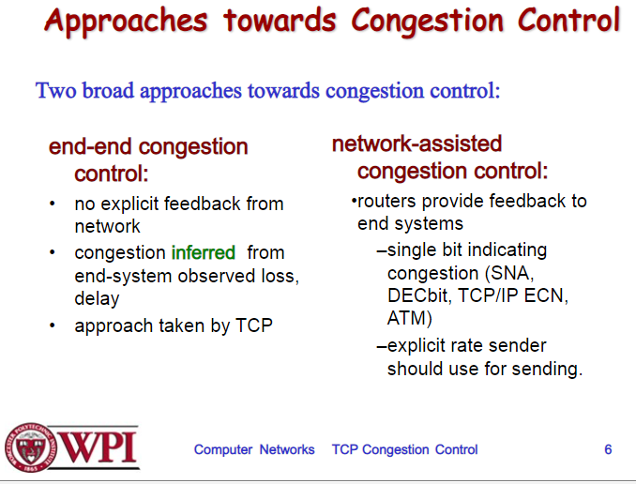

Slide 8
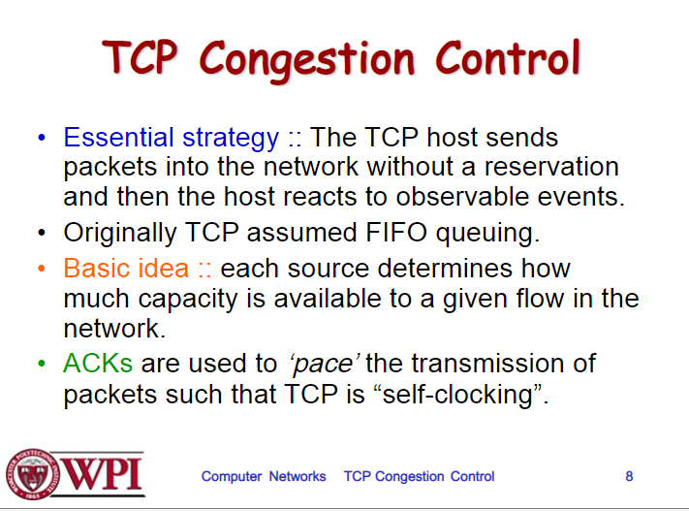

Slide 9
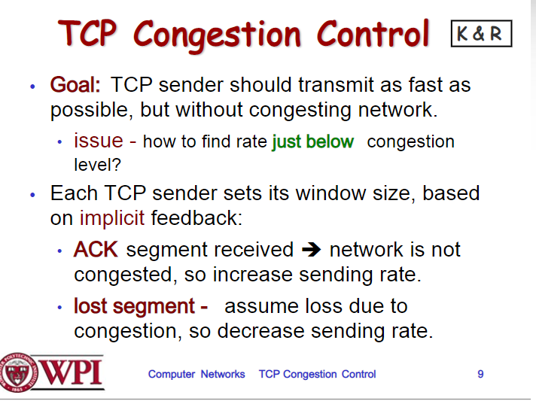

Slide 10
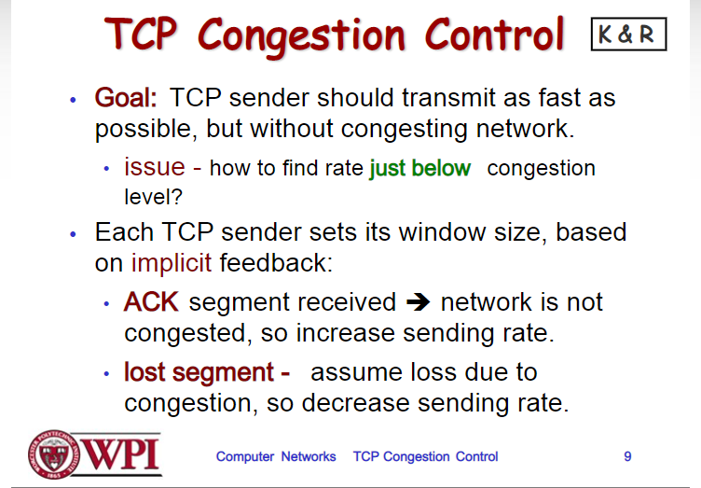

Slide 11
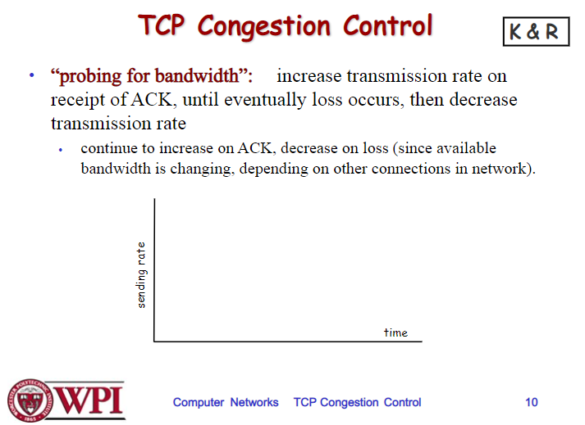

Slide 12
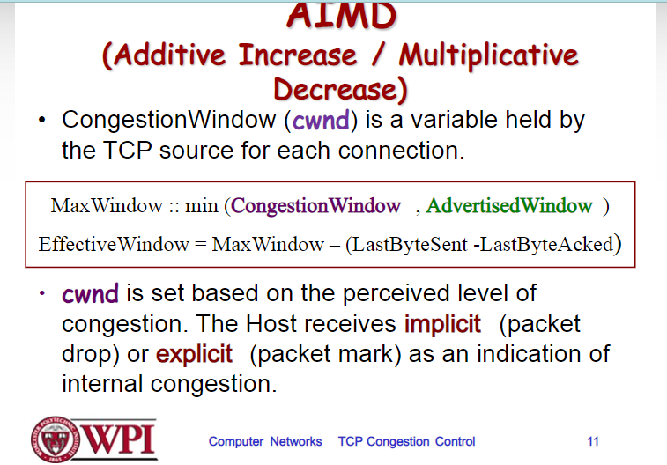

Slide 13
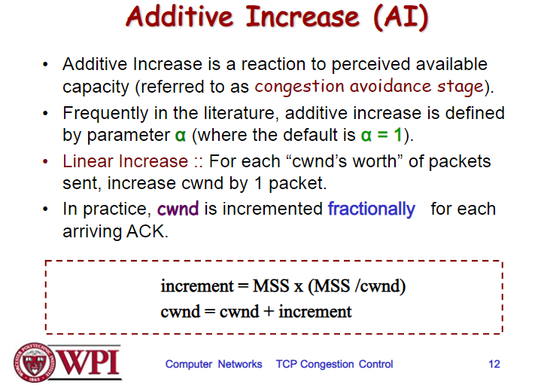

Slide 14
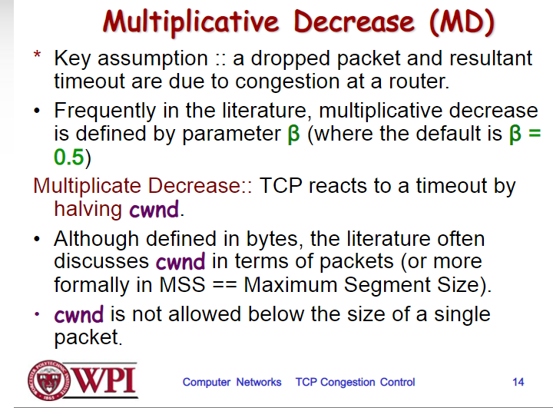

Slide 15
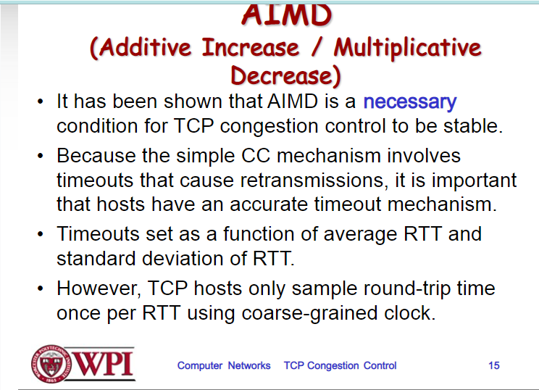

Slide 16
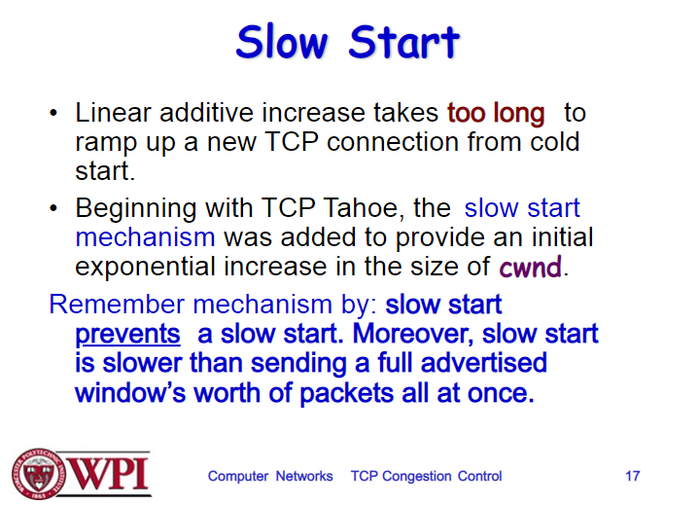

Slide 17
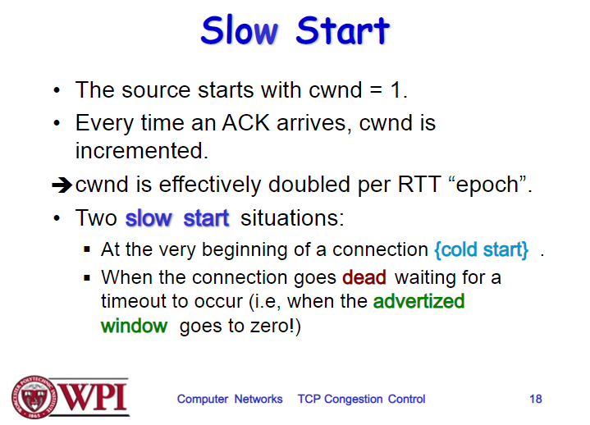

Slide 18
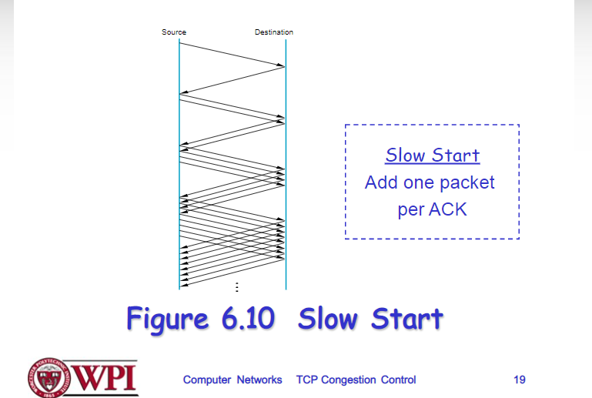

Slide 19
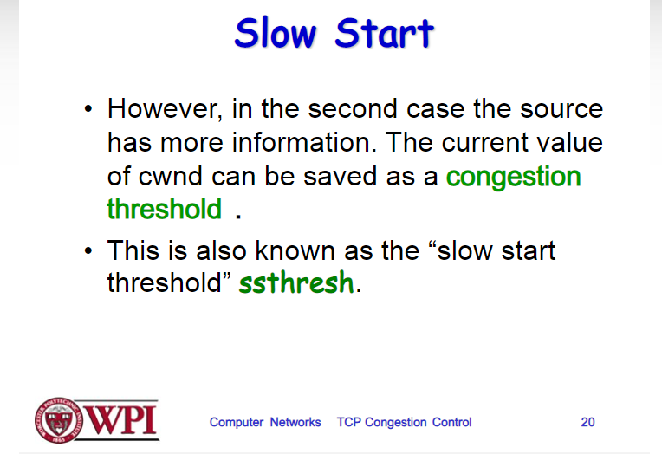

Slide 20
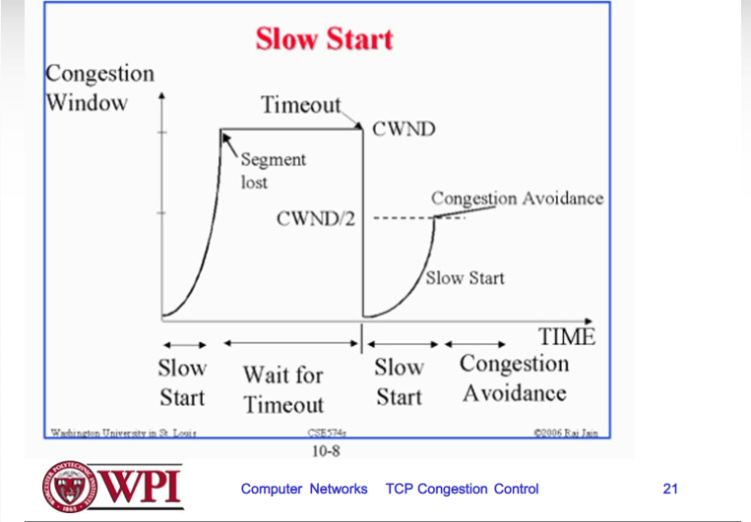

Slide 21
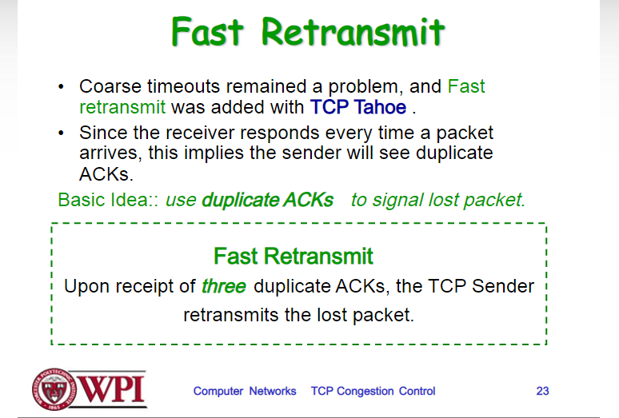

Slide 22
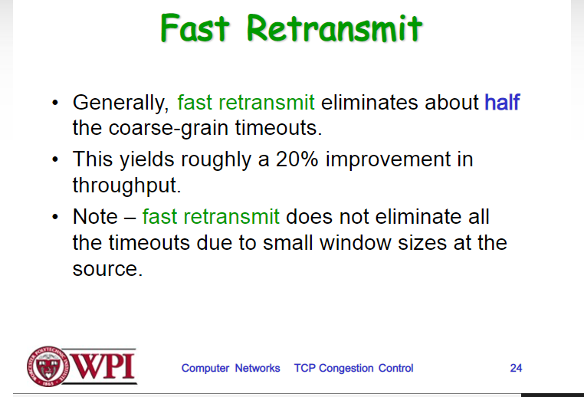

Slide 23
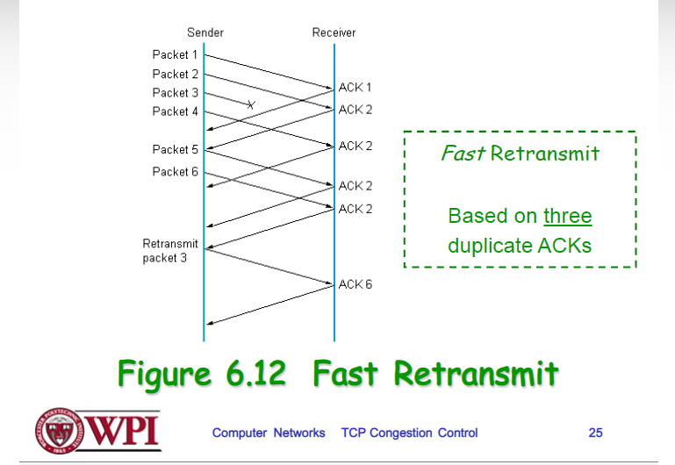

Slide 29
Transport Layer
Function:
Demultiplexing of data streams
Optional functions:
Creating long lived connections
Reliable, in-order packet delivery
Error detection
Flow and congestion control
Key challenges:
Detecting and responding to congestion
Balancing fairness against high utilization
Application
Presentation
Session
Transport
Network
Data Link
Physical

Slide 30
Outline
UDP
TCP
Congestion Control
Evolution of TCP
Problems with TCP

Slide 31




The Case for Multiplexing
Datagram network
No circuits
No connections
Clients run many applications at the same time
Who to deliver packets to?
IP header “protocol” field
8 bits = 256 concurrent streams
Insert Transport Layer to handle demultiplexing
Transport
Network
Data Link
Physical
Packet

Slide 32


Demultiplexing Traffic
Server applications communicate with multiple clients
Host 1
Host 2
Host 3
Unique port for each application
Application
Applications share the same network
Transport
P1
P2
P3
P4
P5
P6
P7
Network
Endpoints identified by <src_ip, src_port, dest_ip, dest_port>

Slide 33
Layering, Revisited
Layers communicate peer-to-peer
Host 1
Router
Host 2
Application
Application
Transport
Transport
Network
Network
Network
Data Link
Data Link
Data Link
Physical
Physical
Physical
Lowest level end-to-end protocol (in theory)
Transport header only read by source and destination
Routers view transport header as payload

Slide 34
User Datagram Protocol (UDP)
0
16
31
Source Port
Destination Port
Payload Length
Checksum
Simple, connectionless datagram
C sockets: SOCK_DGRAM
Port numbers enable demultiplexing
16 bits = 65535 possible ports
Port 0 is invalid
Checksum for error detection
Detects (some) corrupt packets
Does not detect dropped, duplicated, or reordered packets

Slide 35
Uses for UDP
Invented after TCP
Why?
Not all applications can tolerate TCP
Custom protocols can be built on top of UDP
Reliability? Strict ordering?
Flow control? Congestion control?
Examples
RTMP, real-time media streaming (e.g. voice, video)
Facebook datacenter protocol

Slide 36
Outline
UDP
TCP
Congestion Control
Evolution of TCP
Problems with TCP

Slide 37
Transmission Control Protocol
Reliable, in-order, bi-directional byte streams
Port numbers for demultiplexing
Virtual circuits (connections)
Flow control
Congestion control, approximate fairness
Why these features?
0
4
16
31
Source Port
Destination Port
Sequence Number
Acknowledgement Number
HLen
Flags
Advertised Window
Checksum
Urgent Pointer
Options

Slide 38
Connection Setup
Why do we need connection setup?
To establish state on both hosts
Most important state: sequence numbers
Count the number of bytes that have been sent
Initial value chosen at random
Why?
Important TCP flags (1 bit each)
SYN – synchronization, used for connection setup
ACK – acknowledge received data
FIN – finish, used to tear down connection

Slide 39
Three Way Handshake
Client
Server
SYN <SeqC, 0>
Why
Sequence # +1?
SYN/ACK <SeqS, SeqC+1>
ACK <SeqC+1, SeqS+1>
Each side:
Notifies the other of starting sequence number
ACKs the other side’s starting sequence number
Notes:
211

Slide 40
Connection Setup Issues
Connection confusion
How to disambiguate connections from the same host?
Random sequence numbers
Source spoofing
Kevin Mitnick
Need good random number generators!
Connection state management
Each SYN allocates state on the server
SYN flood = denial of service attack
Solution: SYN cookies

Slide 41
Connection Tear Down
Either side can initiate tear down
Other side may continue sending data
Half open connection
shutdown()
Acknowledge the last FIN
Sequence number + 1
Client
Server
FIN <SeqA, *>
ACK <*, SeqA+1>
Data
ACK
FIN <SeqB, *>
ACK <*, SeqB+1>

Slide 42
Sequence Number Space
TCP uses a byte stream abstraction
Each byte in each stream is numbered
32-bit value, wraps around
Initial, random values selected during setup
Byte stream broken down into segments (packets)
Size limited by the Maximum Segment Size (MSS)
Set to limit fragmentation
Each segment has a sequence number
13450
14950
16050
17550
Segment 8
Segment 9
Segment 10

Slide 43
Bidirectional Communication
Seq.
Ack.
Client
Server
Seq.
Ack.
1
23
Data (1460 bytes)
23
1
23
1461
Data/ACK (730 bytes)
1461
753
Data/ACK (1460 bytes)
Data and ACK in the same packet
753
2921
Each side of the connection can send and receive
Different sequence numbers for each direction

Slide 44
Flow Control
Problem: how many packets should a sender transmit?
Too many packets may overwhelm the receiver
Size of the receivers buffers may change over time
Solution: sliding window
Receiver tells the sender how big their buffer is
Called the advertised window
For window size n, sender may transmit n bytes without receiving an ACK
After each ACK, the window slides forward
Window may go to zero!

Slide 45
Flow Control: Sender Side
Packet Sent
Packet Received
Src. Port
Dest. Port
Src. Port
Dest. Port
Sequence Number
Sequence Number
Acknowledgement Number
Acknowledgement Number
HL
Flags
Window
HL
Flags
Window
Checksum
Urgent Pointer
Checksum
Urgent Pointer
Must be buffered until ACKed
App Write
ACKed
Sent
To Be Sent
Outside Window
Window
Notes:
Each side acts and sender and receiver
Every message contains sequence number, even if payload length is zero
Every message contains acknowledgements, even if no data was received
Every message advertises the window size

Slide 46
Sliding Window Example
1
2
3
4
5
6
TCP is ACK Clocked
Short RTT → quick ACK → window slides quickly
Long RTT → slow ACK → window slides slowly
7
5
6
7
Time
Time

Slide 47
What Should the Receiver ACK?
ACK every packet
Use cumulative ACK, where an ACK for sequence n implies ACKS for all k < n
Use negative ACKs (NACKs), indicating which packet did not arrive
Use selective ACKs (SACKs), indicating those that did arrive, even if not in order
SACK is an actual TCP extension

Slide 48
Sequence Numbers, Revisited
32 bits, unsigned
Why so big?
For the sliding window you need…
|Sequence # Space| > 2 * |Sending Window Size|
2³² > 2 * 2¹⁶
Guard against stray packets
IP packets have a maximum segment lifetime (MSL) of 120 seconds
i.e. a packet can linger in the network for 3 minutes
Sequence number would wrap around at 286Mbps
What about GigE? PAWS algorithm + TCP options

Slide 49
Silly Window Syndrome
Problem: what if the window size is very small?
Multiple, small packets, headers dominate data
Equivalent problem: sender transmits packets one byte at a time
for (int x = 0; x < strlen(data); ++x)
write(socket, data + x, 1);
Header
Data
Header
Data
Header
Data
Header
Data

Slide 50
Nagle’s Algorithm
If the window >= MSS and available data >= MSS:
Send the data
Elif there is unACKed data:
Enqueue data in a buffer (send after a timeout)
Else: send the data
Problem: Nagle’s Algorithm delays transmissions
What if you need to send a packet immediately?
int flag = 1;
setsockopt(sock, IPPROTO_TCP, TCP_NODELAY, (char *) &flag, sizeof(int));
Send a full packet
Send a non-full packet if nothing else is happening

Slide 51
Error Detection
Checksum detects (some) packet corruption
Computed over IP header, TCP header, and data
Sequence numbers catch sequence problems
Duplicates are ignored
Out-of-order packets are reordered or dropped
Missing sequence numbers indicate lost packets
Lost segments detected by sender
Use timeout to detect missing ACKs
Need to estimate RTT to calibrate the timeout
Sender must keep copies of all data until ACK

Slide 52
Retransmission Time Outs (RTO)
Problem: time-out is linked to round trip time
Timeout is too short
Initial Send
Initial Send
RTO
RTO
ACK
Retry
Retry
What about if timeout is too long?
ACK

Slide 53
Round Trip Time Estimation
Data
Sample
ACK
Original TCP round-trip estimator
RTT estimated as a moving average
new_rtt = α (old_rtt) + (1 – α)(new_sample)
Recommended α: 0.8-0.9 (0.875 for most TCPs)
RTO = 2 * new_rtt (i.e. TCP is conservative)

Slide 54
RTT Sample Ambiguity
Initial Send
Initial Send
RTO
RTO
ACK
Retry
Sample?
Retry
Sample
ACK
Karn’s algorithm: ignore samples for retransmitted segments

Slide 55
Outline
UDP
TCP
Congestion Control
Evolution of TCP
Problems with TCP

Slide 56
What is Congestion?
Load on the network is higher than capacity
Capacity is not uniform across networks
Modem vs. Cellular vs. Cable vs. Fiber Optics
There are multiple flows competing for bandwidth
Residential cable modem vs. corporate datacenter
Load is not uniform over time
10pm, Sunday night = Bittorrent Game of Thrones

Slide 57
Why is Congestion Bad?
Results in packet loss
Routers have finite buffers, packets must be dropped
Practical consequences
Router queues build up, delay increases
Wasted bandwidth from retransmissions
Low network goodput

Slide 58
The Danger of Increasing Load
Congestion Collapse
Knee – point after which
Throughput increases very slow
Delay increases fast
In an M/M/1 queue
Delay = 1/(1 – utilization)
Cliff – point after which
Throughput → 0
Delay → ∞
Knee
Cliff
Goodput
Ideal point
Load
Delay
Load

Slide 59
Cong. Control vs. Cong. Avoidance
Congestion Avoidance:
Stay left of the knee
Congestion Control:
Stay left of the cliff
Knee
Cliff
Congestion Collapse
Goodput
Load

Slide 60
Advertised Window, Revisited
Does TCP’s advertised window solve congestion?
NO
The advertised window only protects the receiver
A sufficiently fast receiver can max the window
What if the network is slower than the receiver?
What if there are other concurrent flows?
Key points
Window size determines send rate
Window must be adjusted to prevent congestion collapse

Slide 61
Goals of Congestion Control
Adjusting to the bottleneck bandwidth
Adjusting to variations in bandwidth
Sharing bandwidth between flows
Maximizing throughput

Slide 62
General Approaches
Do nothing, send packets indiscriminately
Many packets will drop, totally unpredictable performance
May lead to congestion collapse
Reservations
Pre-arrange bandwidth allocations for flows
Requires negotiation before sending packets
Must be supported by the network
Dynamic adjustment
Use probes to estimate level of congestion
Speed up when congestion is low
Slow down when congestion increases
Messy dynamics, requires distributed coordination

Slide 63


Slide 64
TCP Congestion Control
Each TCP connection has a window
Controls the number of unACKed packets
Sending rate is ~ window/RTT
Idea: vary the window size to control the send rate
Introduce a congestion window at the sender
Congestion control is sender-side problem

Slide 65
Congestion Window (cwnd)
Limits how much data is in transit
Denominated in bytes
wnd = min(cwnd, adv_wnd);
effective_wnd = wnd –
(last_byte_sent – last_byte_acked);
last_byte_acked
last_byte_sent
effective_wnd
wnd

Slide 66
Two Basic Components
Except on wireless networks
Detect congestion
Packet dropping is most reliably signal
Delay-based methods are hard and risky
How do you detect packet drops? ACKs
Timeout after not receiving an ACK
Several duplicate ACKs in a row (ignore for now)
Rate adjustment algorithm
Modify cwnd
Probe for bandwidth
Responding to congestion

Slide 67
Rate Adjustment
Recall: TCP is ACK clocked
Congestion = delay = long wait between ACKs
No congestion = low delay = ACKs arrive quickly
Basic algorithm
Upon receipt of ACK: increase cwnd
Data was delivered, perhaps we can send faster
cwnd growth is proportional to RTT
On loss: decrease cwnd
Data is being lost, there must be congestion
Question: increase/decrease functions to use?

Slide 68
Utilization and Fairness
Max throughput for flow 2
More than full utilization (congestion)
Equal throughput
(fairness)
Less than full utilization
Ideal point
Max efficiency
Perfect fairness
Flow 2 Throughput
Zero throughput for flow 1
Zero throughput for flow 2
Max throughput for flow 1
Flow 1 Throughput

Slide 69
Multiplicative Increase, Additive Decrease
Not stable!
Veers away from fairness
Flow 2 Throughput
Flow 1 Throughput

Slide 70
Additive Increase, Additive Decrease
Stable
But does not converge to fairness
Flow 2 Throughput
Flow 1 Throughput

Slide 71
Multiplicative Increase, Multiplicative Decrease
Stable
But does not converge to fairness
Flow 2 Throughput
Flow 1 Throughput

Slide 72
Additive Increase, Multiplicative Decrease
Converges to stable and fair cycle
Symmetric around y=x
Flow 2 Throughput
Flow 1 Throughput

Slide 73
Implementing Congestion Control
Maintains three variables:
cwnd: congestion window
adv_wnd: receiver advertised window
ssthresh: threshold size (used to update cwnd)
For sending, use: wnd = min(cwnd, adv_wnd)
Two phases of congestion control
Slow start (cwnd < ssthresh)
Probe for bottleneck bandwidth
Congestion avoidance (cwnd >= ssthresh)
AIMD

Slide 74
Slow Start
Knee
Cliff
Goal: reach knee quickly
Upon starting (or restarting) a connection
cwnd =1
ssthresh = adv_wnd
Each time a segment is ACKed, cwnd++
Continues until…
ssthresh is reached
Or a packet is lost
Slow Start is not actually slow
cwnd increases exponentially
Goodput
Load

Slide 75
Slow Start Example
cwnd = 1
cwnd grows rapidly
Slows down when…
cwnd >= ssthresh
Or a packet drops
1
cwnd = 2
2
3
cwnd = 4
4
5
6
7
cwnd = 8

Slide 76
Congestion Avoidance
AIMD mode
ssthresh is lower-bound guess about location of the knee
If cwnd >= ssthresh then each time a segment is ACKed increment cwnd by 1/cwnd (cwnd += 1/cwnd).
So cwnd is increased by one only if all segments have been acknowledged

Slide 77
Congestion Avoidance Example
cwnd = 1
cwnd = 2
cwnd >= ssthresh
cwnd = 4
ssthresh = 8
cwnd (in segments)
Slow Start
cwnd = 8
cwnd = 9
Round Trip Times

Slide 78
TCP Pseudocode
Initially: cwnd = 1; ssthresh = adv_wnd;
New ack received: if (cwnd < ssthresh) /* Slow Start*/ cwnd = cwnd + 1; else /* Congestion Avoidance */ cwnd = cwnd + 1/cwnd;
Timeout: /* Multiplicative decrease */ ssthresh = cwnd/2; cwnd = 1;

Slide 79
The Big Picture
ssthresh
Timeout
Congestion
Avoidance
cwnd
Slow Start
Time

Slide 80
Outline
UDP
TCP
Congestion Control
Evolution of TCP
Problems with TCP

Slide 81
The Evolution of TCP
Thus far, we have discussed TCP Tahoe
Original version of TCP
However, TCP was invented in 1974!
Today, there are many variants of TCP
Early, popular variant: TCP Reno
Tahoe features, plus…
Fast retransmit
Fast recovery

Slide 82
TCP Reno: Fast Retransmit
Problem: in Tahoe, if segment is lost, there is a long wait until the RTO
Reno: retransmit after 3 duplicate ACKs
cwnd = 1
1
2
cwnd = 2
2
3
3
4
cwnd = 4
4
5
6
7
4
3 Duplicate ACKs
4
4

Slide 83
TCP Reno: Fast Recovery
After a fast-retransmit set cwnd to ssthresh/2
i.e. don’t reset cwnd to 1
Avoid unnecessary return to slow start
Prevents expensive timeouts
But when RTO expires still do cwnd = 1
Return to slow start, same as Tahoe
Indicates packets aren’t being delivered at all
i.e. congestion must be really bad

Slide 84
Fast Retransmit and Fast Recovery
ssthresh
Timeout
Congestion Avoidance
Fast Retransmit/Recovery
Timeout
cwnd
Slow Start
Time
At steady state, cwnd oscillates around the optimal window size
TCP always forces packet drops

Slide 85
Many TCP Variants…
Tahoe: the original
Slow start with AIMD
Dynamic RTO based on RTT estimate
Reno: fast retransmit and fast recovery
NewReno: improved fast retransmit
Each duplicate ACK triggers a retransmission
Problem: >3 out-of-order packets causes pathological retransmissions
Vegas: delay-based congestion avoidance
And many, many, many more…

Slide 86
TCP in the Real World
What are the most popular variants today?
Key problem: TCP performs poorly on high bandwidth-delay product networks (like the modern Internet)
Compound TCP (Windows)
Based on Reno
Uses two congestion windows: delay based and loss based
Thus, it uses a compound congestion controller
TCP CUBIC (Linux)
Enhancement of BIC (Binary Increase Congestion Control)
Window size controlled by cubic function
Parameterized by the time T since the last dropped packet

Slide 87
High Bandwidth-Delay Product
Key Problem: TCP performs poorly when
The capacity of the network (bandwidth) is large
The delay (RTT) of the network is large
Or, when bandwidth * delay is large
b * d = maximum amount of in-flight data in the network
a.k.a. the bandwidth-delay product
Why does TCP perform poorly?
Slow start and additive increase are slow to converge
TCP is ACK clocked
i.e. TCP can only react as quickly as ACKs are received
Large RTT → ACKs are delayed → TCP is slow to react

Slide 88
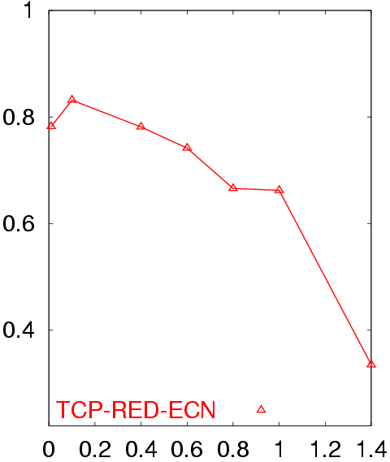
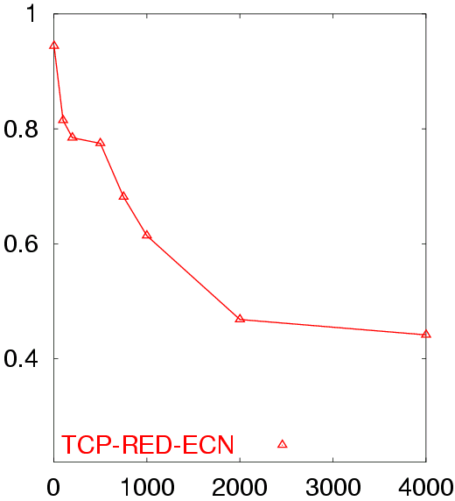
Poor Performance of TCP Reno CC
50 flows in both directions
Buffer = BW x Delay
RTT = 80 ms
50 flows in both directions
Buffer = BW x Delay
BW = 155 Mb/s
Avg. TCP Utilization
Avg. TCP Utilization
Bottleneck Bandwidth (Mb/s)
Round Trip Delay (sec)

Slide 89
Goals
Fast window growth
Slow start and additive increase are too slow when bandwidth is large
Want to converge more quickly
Maintain fairness with other TCP varients
Window growth cannot be too aggressive
Improve RTT fairness
TCP Tahoe/Reno flows are not fair when RTTs vary widely
Simple implementation

Slide 90
Compound TCP Implementation
Default TCP implementation in Windows
Key idea: split cwnd into two separate windows
Traditional, loss-based window
New, delay-based window
wnd = min(cwnd + dwnd, adv_wnd)
cwnd is controlled by AIMD
dwnd is the delay window
Rules for adjusting dwnd:
If RTT is increasing, decrease dwnd (dwnd >= 0)
If RTT is decreasing, increase dwnd
Increase/decrease are proportional to the rate of change

Slide 91
Compound TCP Example
Faster cwnd growth
High
RTT
Low
RTT
Slower cwnd growth
Timeout
Timeout
cwnd
Slow Start
Time
Aggressiveness corresponds to changes in RTT
Advantages: fast ramp up, more fair to flows with different RTTs
Disadvantage: must estimate RTT, which is very challenging

Slide 92
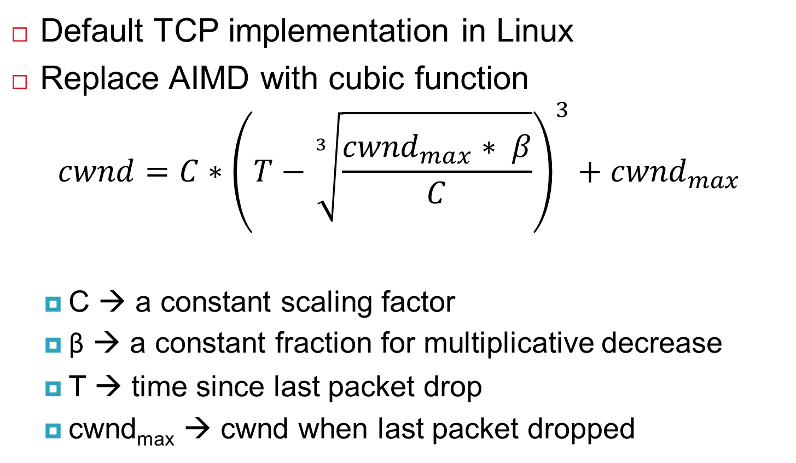
TCP CUBIC Implementation
Default TCP implementation in Linux
Replace AIMD with cubic function
$$cwnd=C∗{\left(T−\sqrt[3]{\frac{{cwnd}_{max}∗ β}{C}}\right)}^{3}+{cwnd}_{max}$$
C → a constant scaling factor
β → a constant fraction for multiplicative decrease
T → time since last packet drop
cwnd_{max} → cwnd when last packet dropped

Slide 93
TCP CUBIC Example
Slowly accelerate to probe for bandwidth
CUBIC Function
Timeout
cwnd_{max}
cwnd
Stable
Region
Slow Start
Fast ramp up
Time
Less wasted bandwidth due to fast ramp up
Stable region and slow acceleration help maintain fairness
Fast ramp up is more aggressive than additive increase
To be fair to Tahoe/Reno, CUBIC needs to be less aggressive

Slide 94
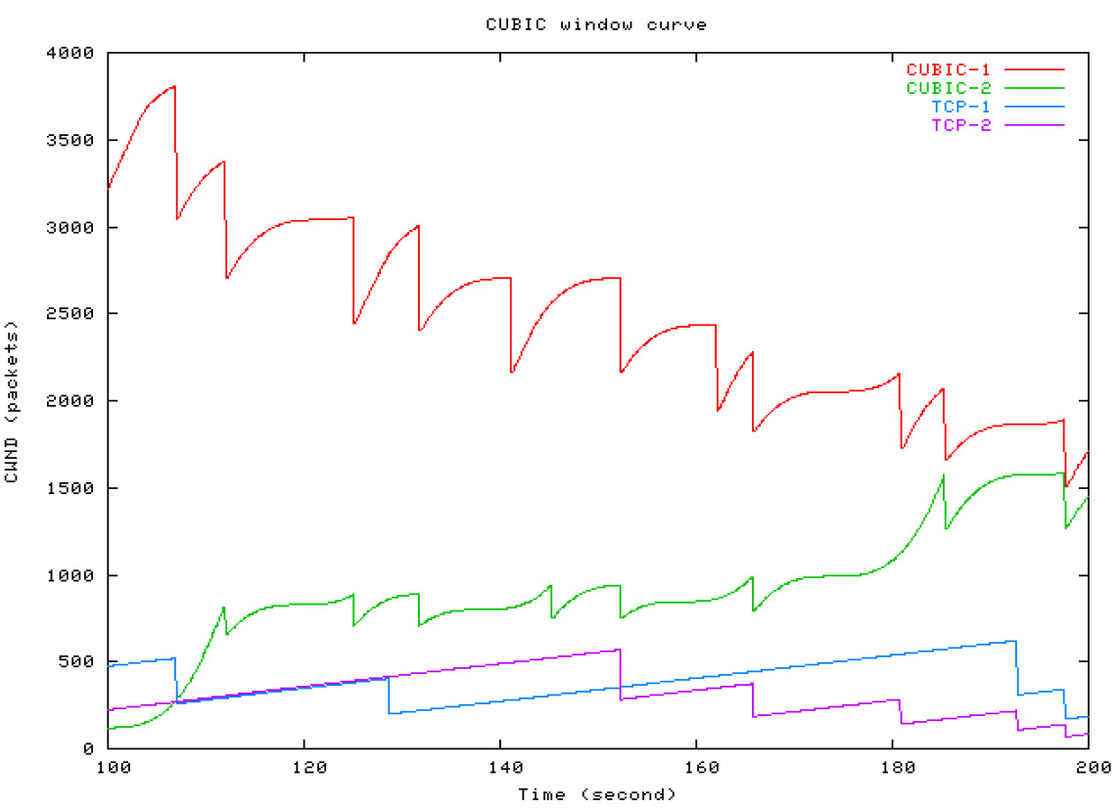
Simulations of CUBIC Flows
CUBIC
CUBIC
Reno
Reno

Slide 95
Deploying TCP Variants
TCP assumes all flows employ TCP-like congestion control
TCP-friendly or TCP-compatible
Violated by UDP :(
If new congestion control algorithms are developed, they must be TCP-friendly
Be wary of unforeseen interactions
Variants work well with others like themselves
Different variants competing for resources may trigger unfair, pathological behavior

Slide 96
Outline
UDP
TCP
Congestion Control
Evolution of TCP
Problems with TCP

Slide 97
Common TCP Options
0
4
16
31
Source Port
Destination Port
Sequence Number
Acknowledgement Number
HLen
Flags
Advertised Window
Checksum
Urgent Pointer
Options
Window scaling
SACK: selective acknowledgement
Maximum segment size (MSS)
Timestamp

Slide 98
Window Scaling
Problem: the advertised window is only 16-bits
Effectively caps the window at 65536B, 64KB
Example: 1.5Mbps link, 513ms RTT
(1.5Mbps * 0.513s) = 94KB
64KB / 94KB = 68% of maximum possible speed
Solution: introduce a window scaling value
wnd = adv_wnd << wnd_scale;
Maximum shift is 14 bits, 1GB maximum window

Slide 99
SACK: Selective Acknowledgment
Problem: duplicate ACKs only tell us about 1 missing packet
Multiple rounds of dup ACKs needed to fill all holes
Solution: selective ACK
Include received, out-of-order sequence numbers in TCP header
Explicitly tells the sender about holes in the sequence
4
5
6
7
4
8
9
4
10
11
4
4
4

Slide 100
Other Common Options
Maximum segment size (MSS)
Essentially, what is the hosts MTU
Saves on path discovery overhead
Timestamp
When was the packet sent (approximately)?
Used to prevent sequence number wraparound
PAWS algorithm

Slide 101
Issues with TCP
The vast majority of Internet traffic is TCP
However, many issues with the protocol
Lack of fairness
Synchronization of flows
Poor performance with small flows
Really poor performance on wireless networks
Susceptibility to denial of service

Slide 102

Fairness
Problem: TCP throughput depends on RTT
100 ms
1 Mbps
1 Mbps
1 Mbps
1 Mbps
1 Mbps
1000 ms
ACK clocking makes TCP inherently unfair
Possible solution: maintain a separate delay window
Implemented by Microsoft’s Compound TCP

Slide 103
Synchronization of Flows
Oscillating, but high overall utilization
Ideal bandwidth sharing
cwnd
cwnd
In reality, flows synchronize
One flow causes all flows to drop packets
Periodic lulls of low utilization
cwnd

Slide 104
Small Flows
Problem: TCP is biased against short flows
1 RTT wasted for connection setup (SYN, SYN/ACK)
cwnd always starts at 1
Vast majority of Internet traffic is short flows
Mostly HTTP transfers, <100KB
Most TCP flows never leave slow start!
Proposed solutions (driven by Google):
Increase initial cwnd to 10
TCP Fast Open: use cryptographic hashes to identify receivers, eliminate the need for three-way handshake

Slide 105
Wireless Networks
Problem: Tahoe and Reno assume loss = congestion
True on the WAN, bit errors are very rare
False on wireless, interference is very common
TCP throughput ~ 1/sqrt(drop rate)
Even a few interference drops can kill performance
Possible solutions:
Break layering, push data link info up to TCP
Use delay-based congestion detection (TCP Vegas)
Explicit congestion notification (ECN)
More on this next week…

Slide 106
Denial of Service
Problem: TCP connections require state
Initial SYN allocates resources on the server
State must persist for several minutes (RTO)
SYN flood: send enough SYNs to a server to allocate all memory/meltdown the kernel
Solution: SYN cookies
Idea: don’t store initial state on the server
Securely insert state into the SYN/ACK packet
Client will reflect the state back to the server

Slide 107
SYN Cookies
0
5
8
31
Sequence Number
Timestamp
MSS
Crypto Hash of Client IP & Port
Did the client really send me a SYN recently?
Timestamp: freshness check
Cryptographic hash: prevents spoofed packets
Maximum segment size (MSS)
Usually stated by the client during initial SYN
Server should store this value…
Reflect the clients value back through them

Slide 108
SYN Cookies in Practice
Advantages
Effective at mitigating SYN floods
Compatible with all TCP versions
Only need to modify the server
No need for client support
Disadvantages
MSS limited to 3 bits, may be smaller than clients actual MSS
Server forgets all other TCP options included with the client’s SYN
SACK support, window scaling, etc.

